Slide 1
Agenda
Administrative
Introduction to Agile Project Management
Syllabus
Poll Everywhere

Slide 2
Poll Everywhere
Detailed instructions available via eLearning
Must create a registered account
Cost $14
Respond via browser
www.pollev.com/thouin

Slide 3
What is a Project?
Project Defined
A complex, nonroutine, one-time effort limited by time, budget, resources, and performance specifications designed to meet customer needs.
Major Characteristics of a Project
Has an established objective
Has a defined life span with a beginning and an end
Requires across-the-organizational participation
Involves doing something never been done before
Has specific time, cost, and performance requirements

Slide 4
Project Success
Under what conditions is a project deemed to have been successful?

Slide 5
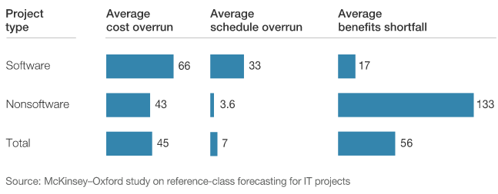
Project Performance Varies Greatly
Notes:
Part of a survey of 5,400 IT projects with budgets greater than $15 million
“On average, large IT projects run 45 percent over budget and 7 percent over time, while delivering 56 percent less value than predicted. Software projects run the highest risk of cost and schedule overruns¹.” http://www.mckinsey.com/insights/business_technology/delivering_large-scale_it_projects_on_time_on_budget_and_on_value

Slide 6
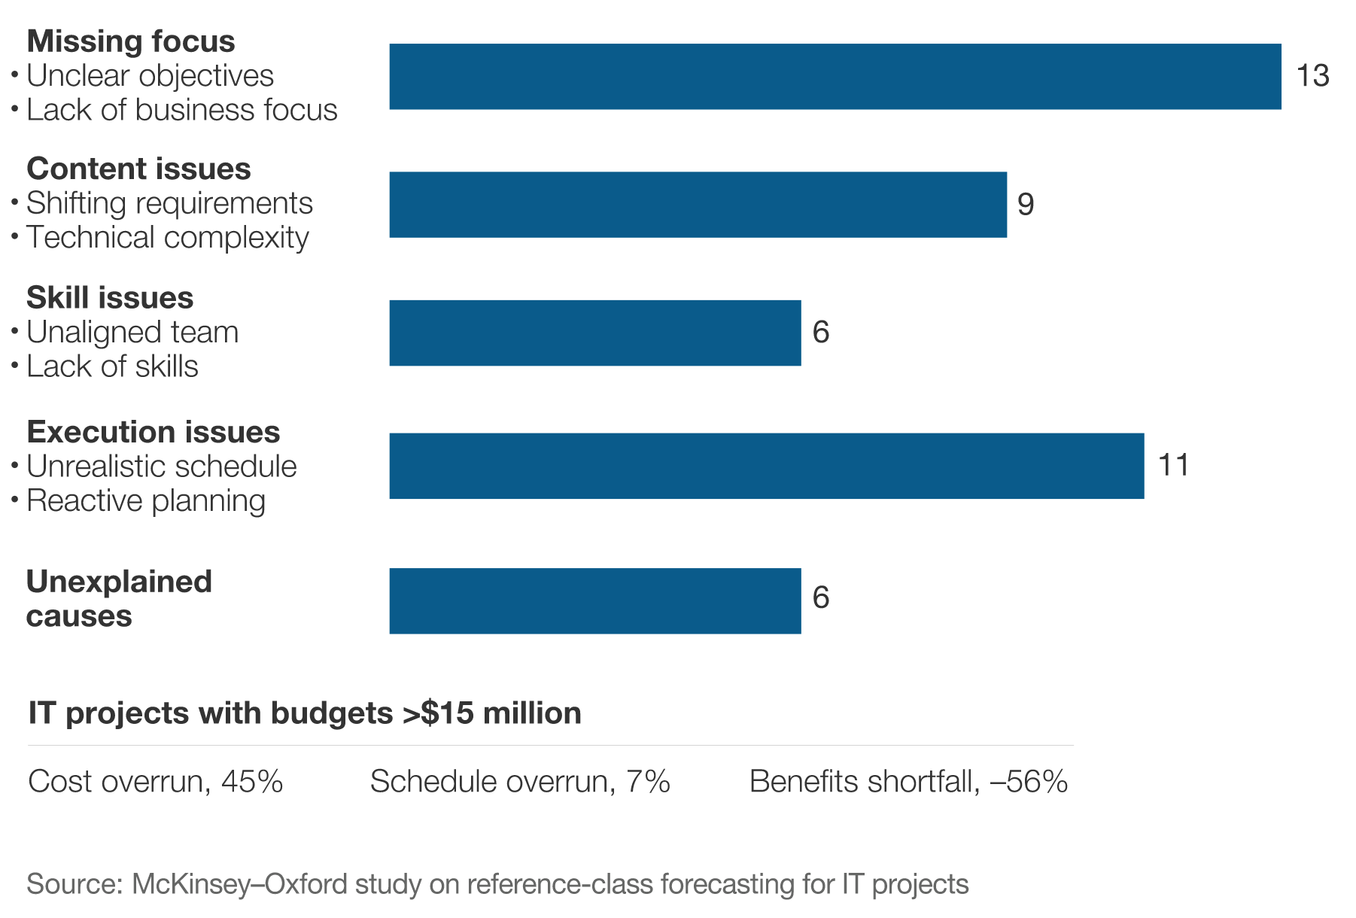
Causes of Cost Overruns

Slide 7
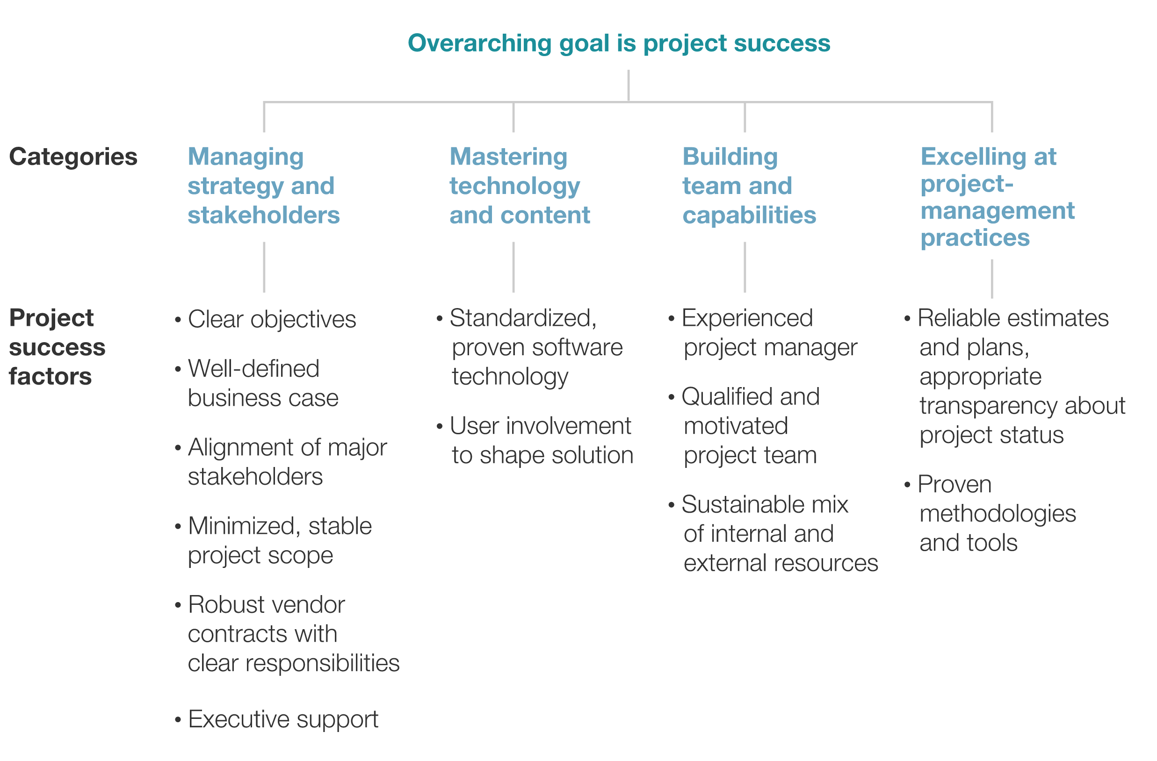
Project Success Factors
Notes:
How do we define project success?

Slide 8
What is Project Management?
Project management is the application of knowledge, skills, tools and techniques to project activities to meet the project requirements
Source: PMBOK

Slide 9
Business Alignment
Organizational Mission, Vision, Core Values, Objectives
Organizations create strategic plans to achieve objectives
Portfolio, program and project management ensures alignment with strategic plan
Portfolio Management
Collection of programs that are grouped together to facility effective management and alignment with strategic plan (e.g. Microsoft Business Solutions)
Program Management
Collection of projects that are grouped together to facility effective management and alignment with strategic plan (e.g. Microsoft Office 365)
Project Management
Focus on achieving project objectives (e.g. Microsoft Word 365)

Slide 10
Project Success
At or under budget
At or ahead of schedule
All required features and benefits
Stakeholder satisfaction
Importance of conversations with stakeholders
Achieves desired outcomes
Other?

Slide 11
Software Project Management
Project Management
PMI PMBOK Fifth Edition
5 Process Groups, 10 Knowledge Areas, 47 Processes
Project Delivery
Systems Development Lifecycles (SDLC)
Waterfall
Iterative
Agile

Slide 12
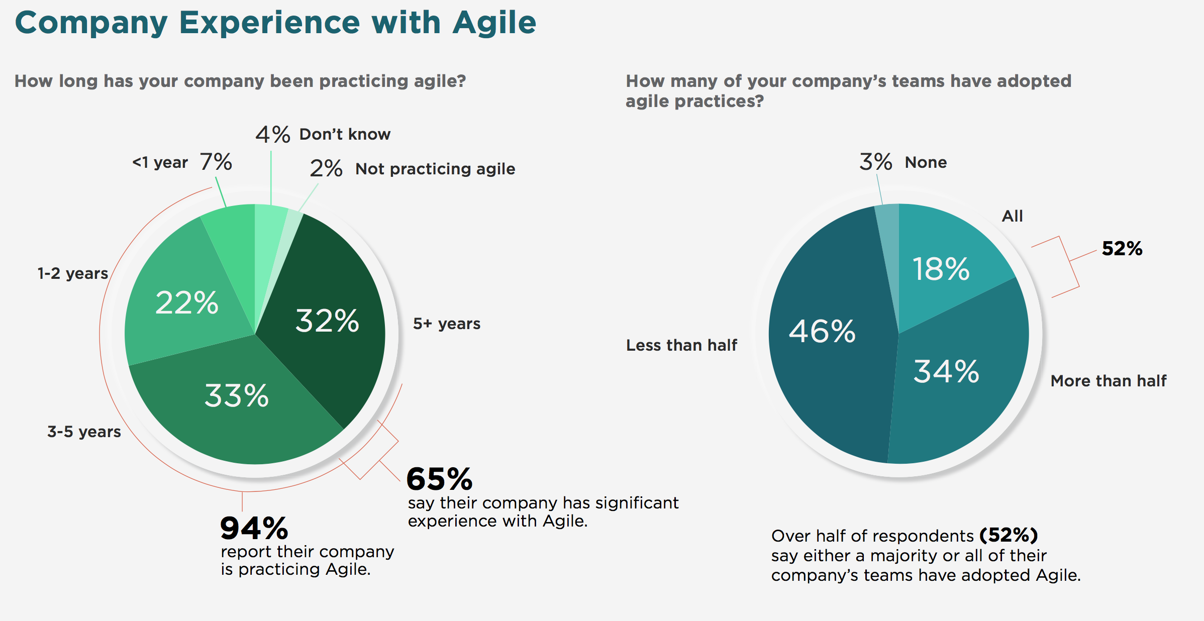
15th Annual State of Agile Survey
Source: Digital.ai www.stateofagile.com
Notes:
40,000 respondents

Slide 13
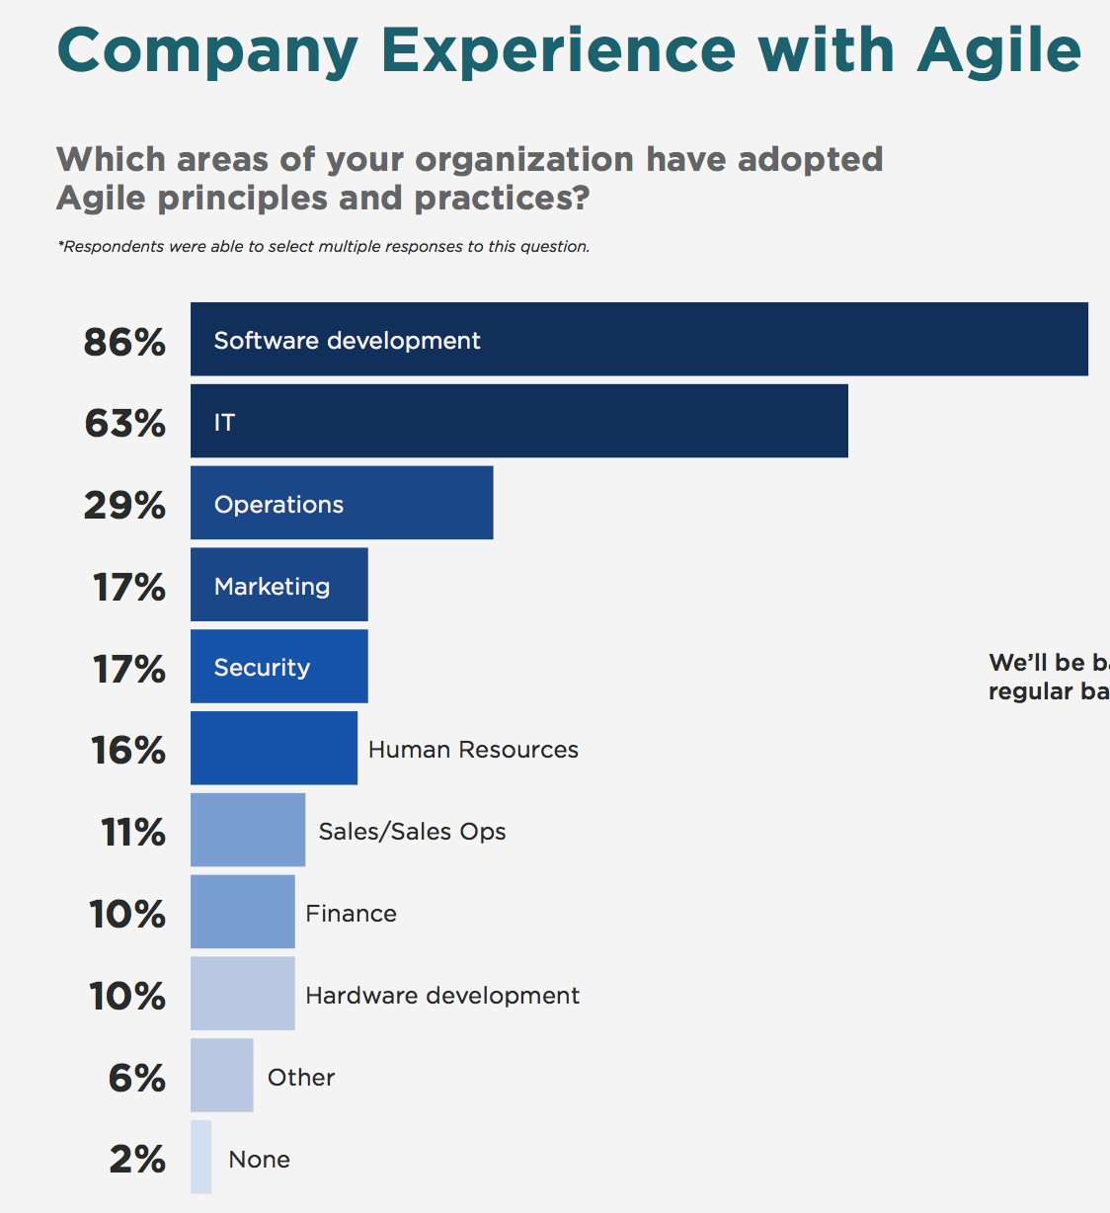
15th Annual State of Agile Survey
Source: Digital.ai www.stateofagile.com
Notes:
40,000 respondents

Slide 14
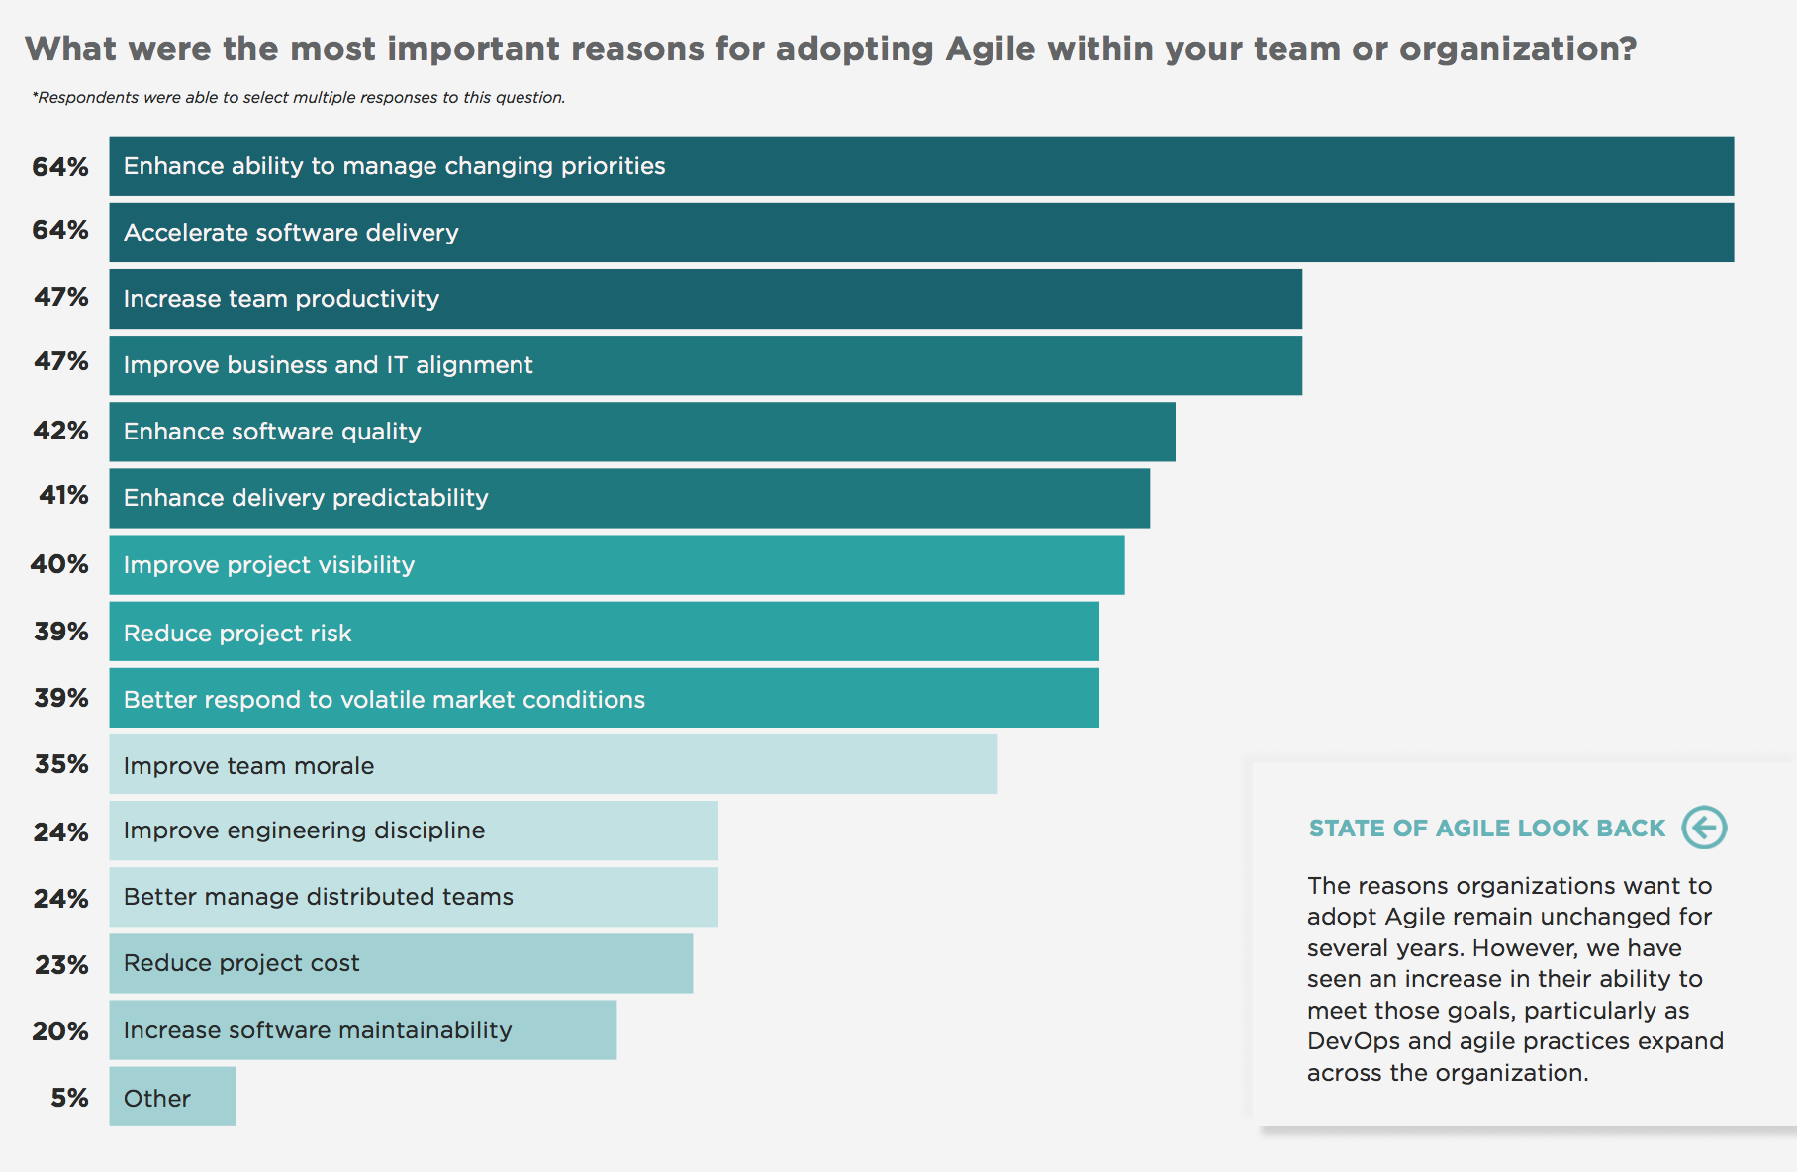
15th Annual State of Agile Survey
Source: Digital.al www.stateofagile.com

Slide 15
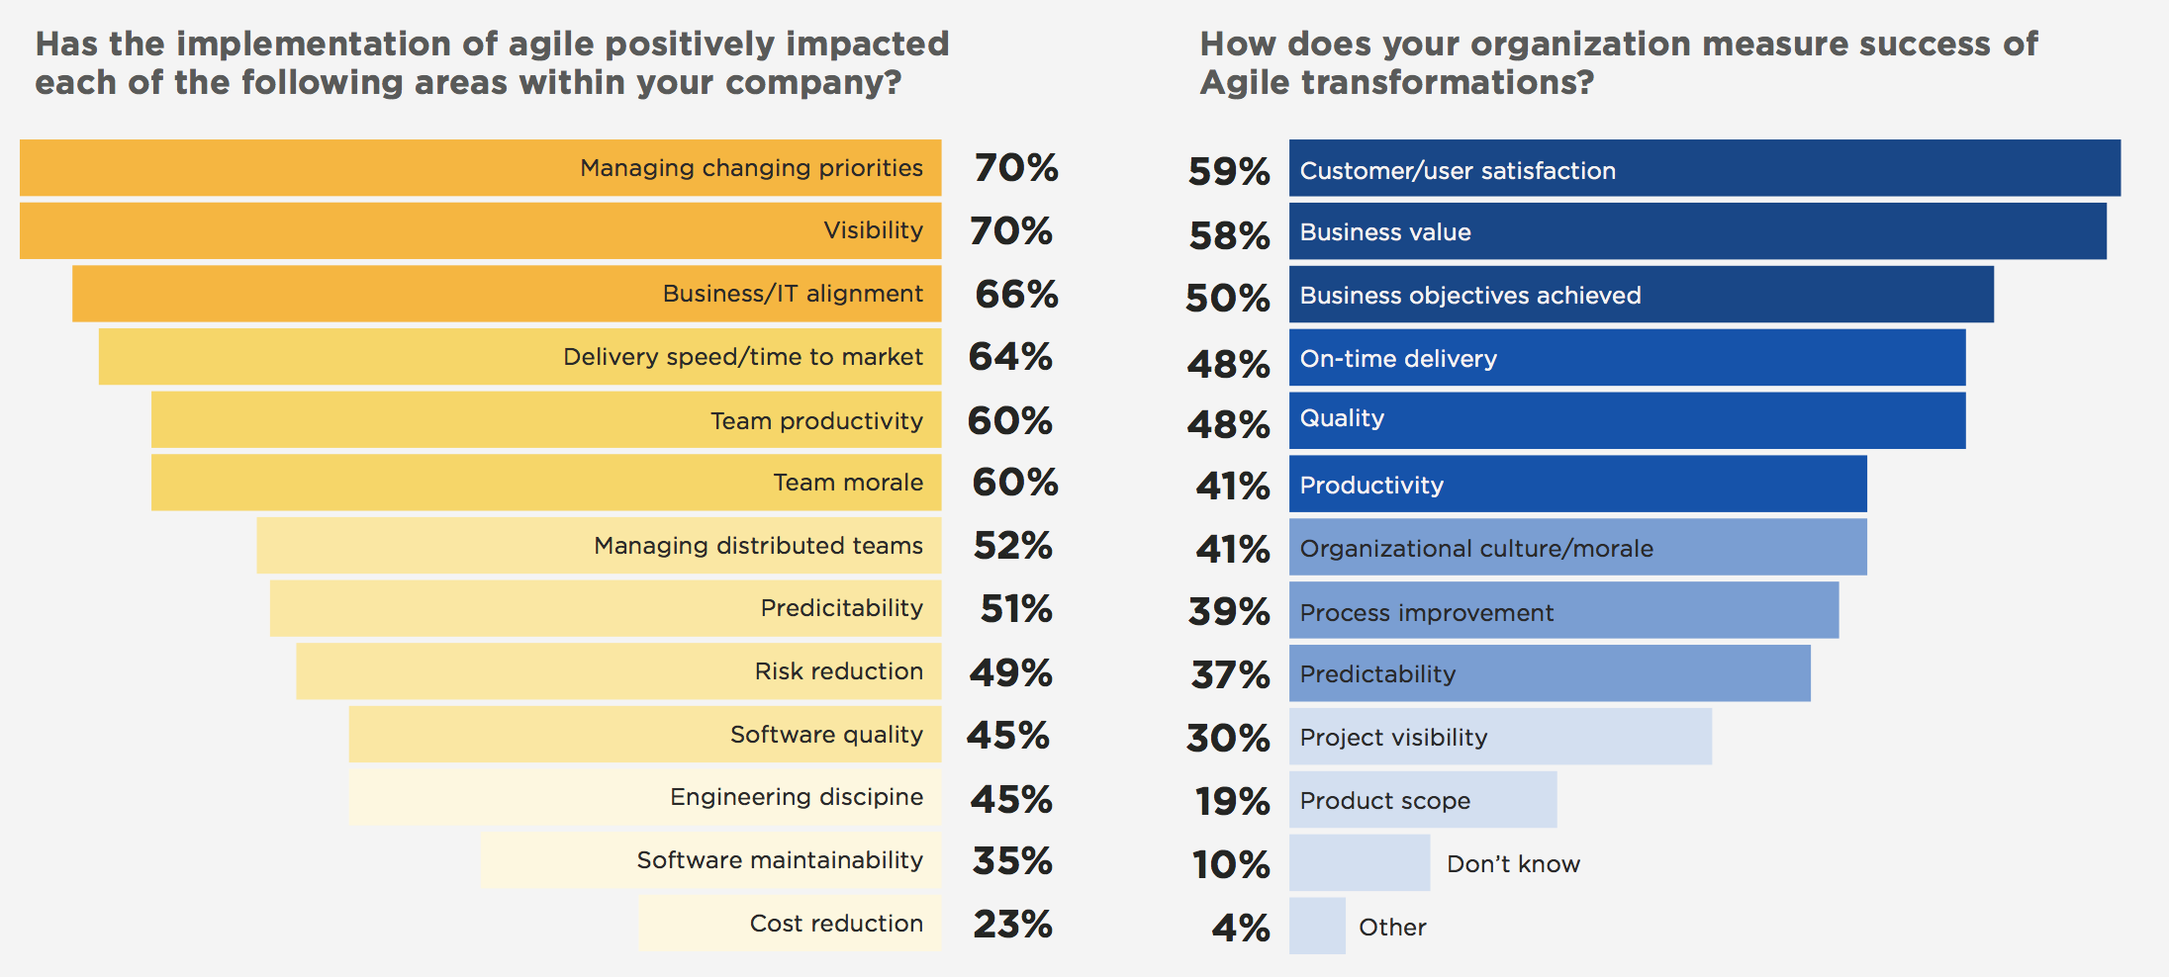
15th Annual State of Agile Survey
Source: Digital.al www.stateofagile.com

Slide 16
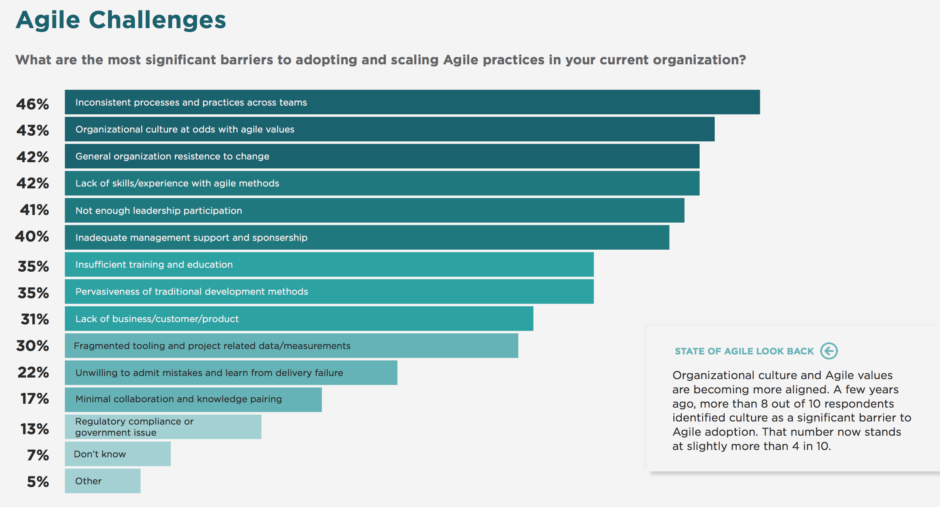
15th Annual State of Agile Survey
Source: Digital.al www.stateofagile.com

Slide 17
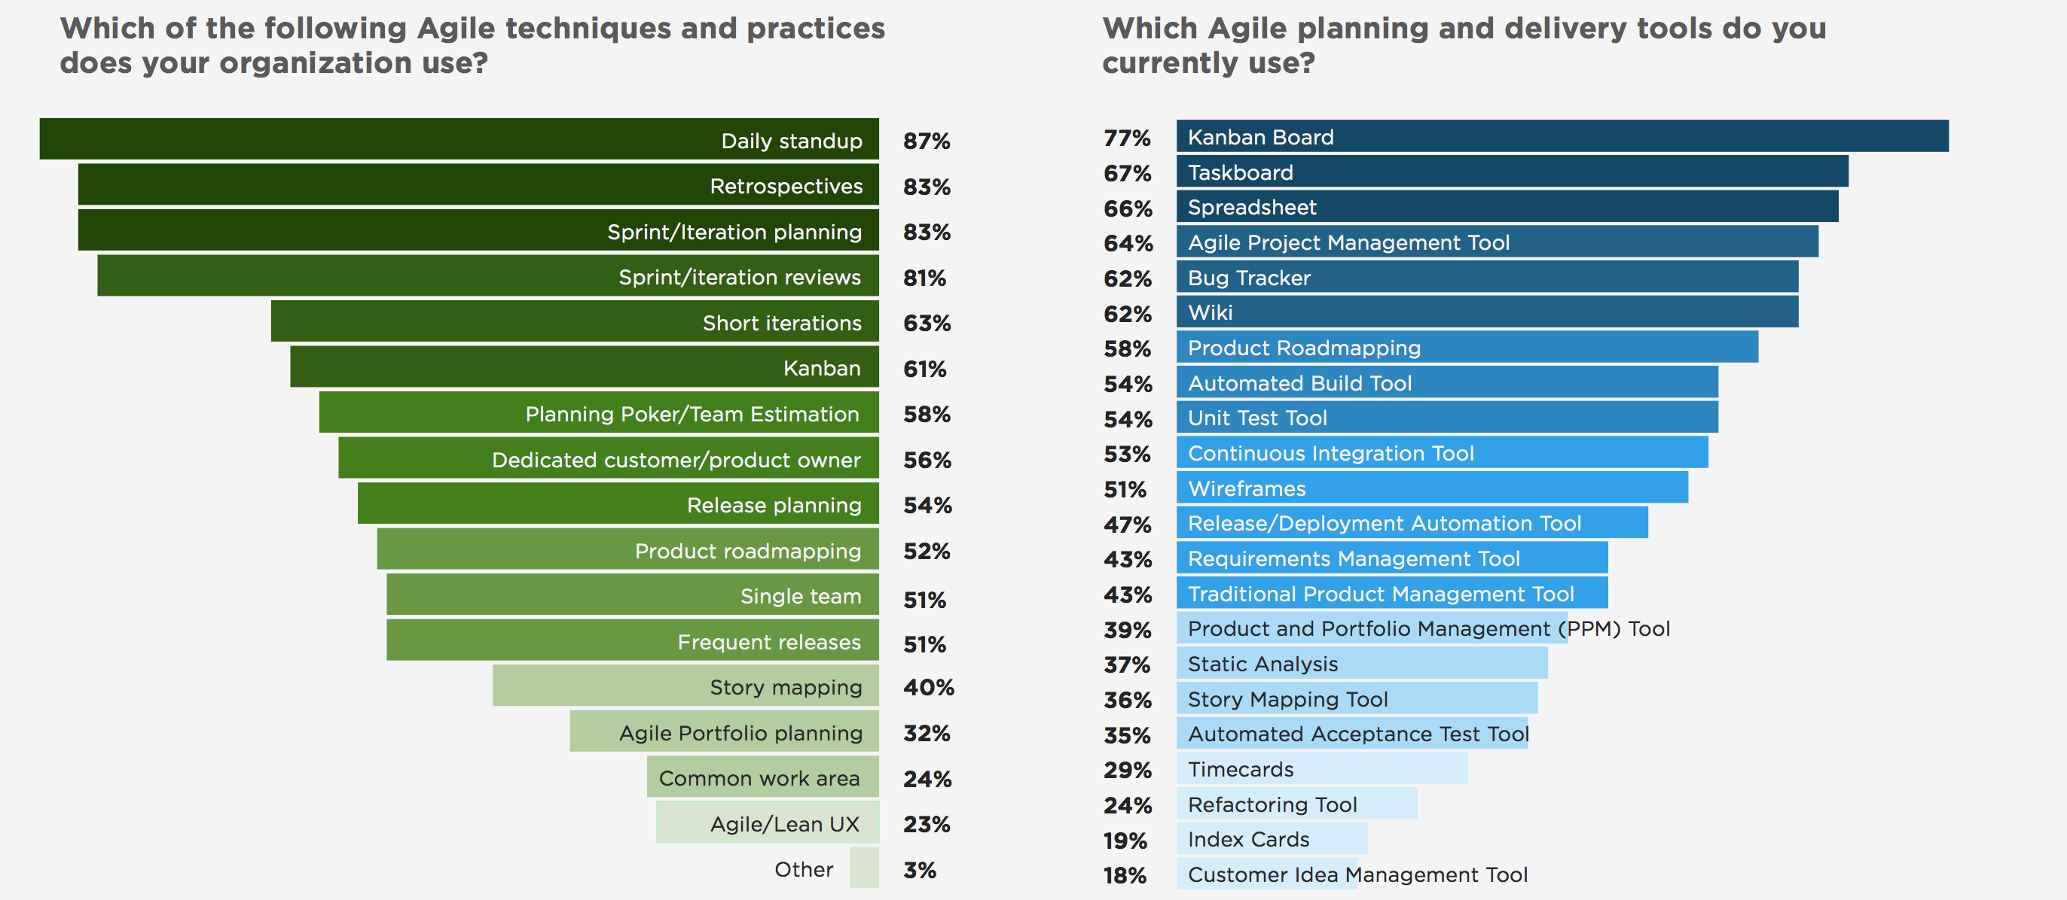

Slide 18
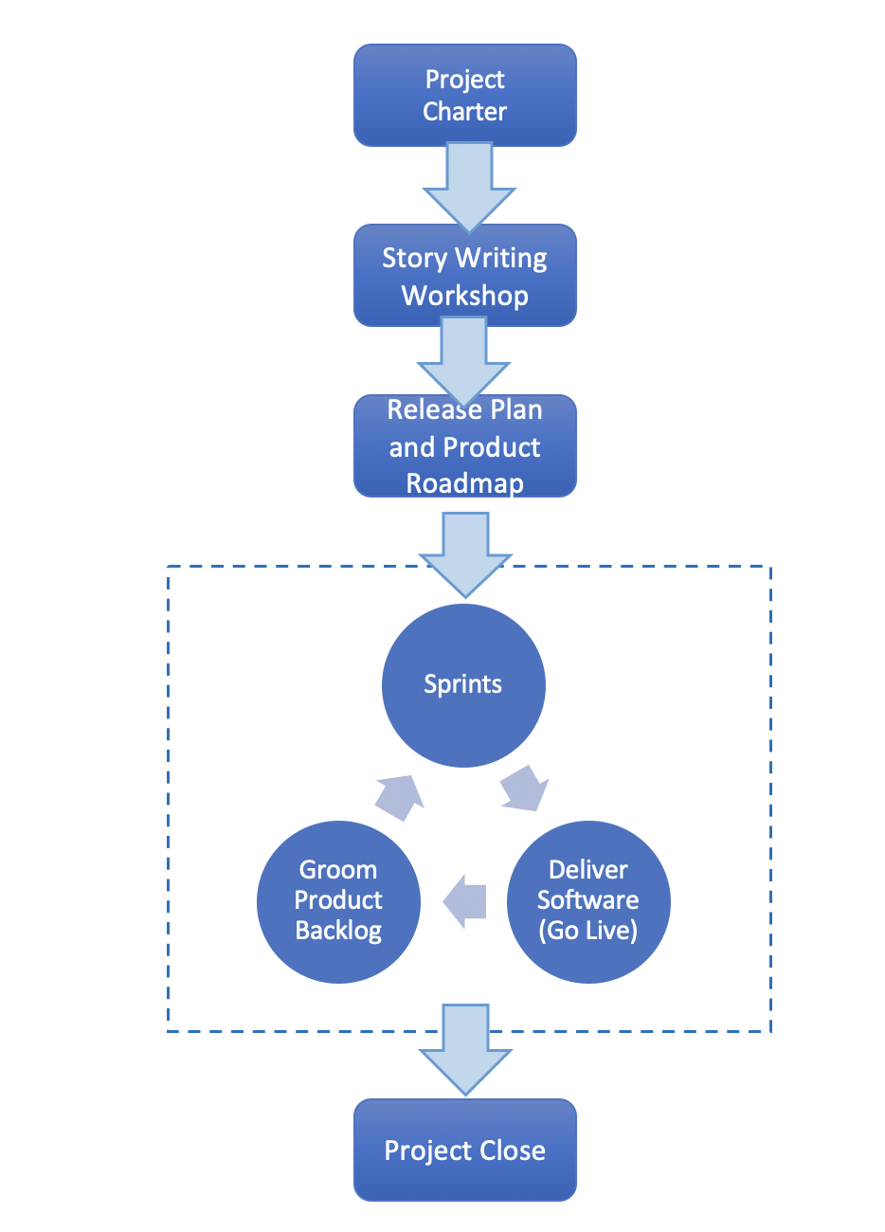
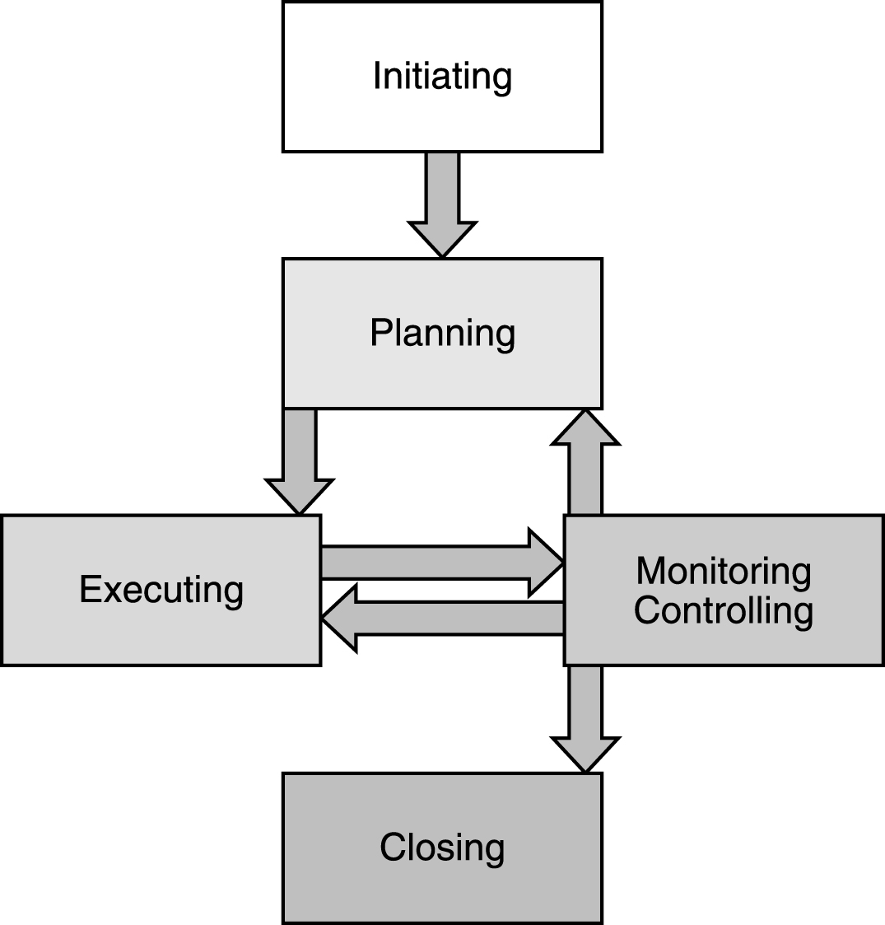
Understanding the Project Lifecycle
Planned – PMI PMBOK
Adaptive - Scrum/Agile
PMP in Depth: Project Management Professional Study Guide for PMP and CAPM Exams

Slide 19
Project Management - Process Groups
Initiating
Planning
Executing
Monitoring/Controlling
Closing
PMP in Depth: Project Management Professional Study Guide for PMP and CAPM Exams

Slide 20
Project Management Process Groups
Stage (Process Group) | Main Goal | Main Output
Initiating | Authorize the Project | Project charter and stakeholder register
Planning | Plan and schedule the work to perform the project | Project management plan that contains subsidiary plans, such as scope management plan and schedule management plan
Executing | Perform the project work | Project deliverables: product, service, result
Monitoring and Controlling | Monitor the progress of the project to identify the variance from the plan and to correct it | Change requests and recommendations for preventive and corrective action
Closing | Close the project formally | Product acceptance and contract closure
PMP in Depth

Slide 21
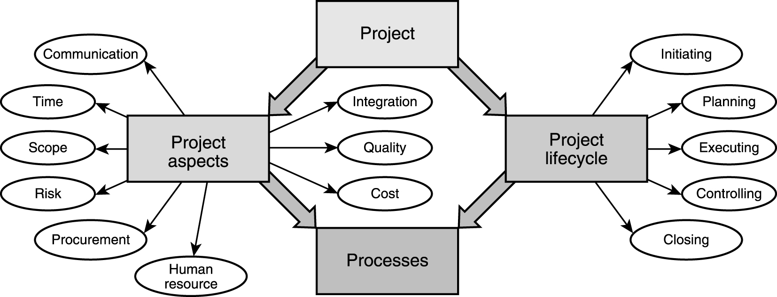
Big Picture of Project Management
Stakeholder Management
Notes:
5 Process Groups, 10 Knowledge Areas, 47 Processes

Slide 22
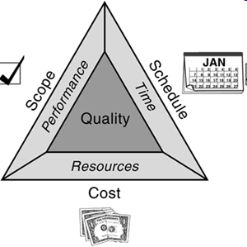
The Triple Constraint (The Iron Triangle)
Quality Software Project Management
PMP in Depth

Slide 23
Project Delivery - Waterfall SDLC
Requirements
Design
Develop
Test
Implement

Slide 24
Project Delivery – Scrum SDLC

Slide 25
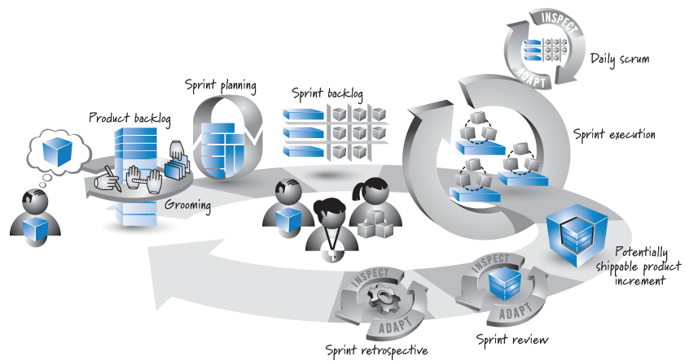
Scrum Sprint
Source: Essential Scrum by Kenneth S. Rubin p. 17
Notes:
Agile software development emphasizes agility and the ability to adapt to changing conditions
Time boxed deliverables
Limited up-front planning, frequent product deliverables, limited documentation, and quick daily meetings with team and customers

Slide 26
The Project Manager
Person responsible for achieving project objectives
Different from a functional manager
Different from a Scrum Master
Must be able to effectively use and apply project management principles
Interpersonal skills
Leadership Political and cultural awareness
Team building Negotiation
Motivation Trust building
Communication Conflict Management
Influencing Coaching
Decision making
PMP in Depth

Slide 27
Scrum
Scrum Master
Helps everyone involved understand Scrum values, principles and practices
Coach, servant leader, process authority, impediment remover, influencer
Product Owner
Single point of product leadership
Developers
Perform the work required to build the software product

Slide 28
Exercise
Quantum Bank

Slide 29
Group Project Signup
Group Projects
Microsoft Project Professional 2019
Poll Everywhere

